Slide 1
BA Training Day 3

Slide 2

Review of Day 2
Types of Project
Change & Service Request
Scope & Scope Creep
Pre-Project Phase
Feasibility Study
Project Charter
RFP, ROI & KPI
SWOT
Introduction to Requirements
Vendor Screening

Slide 3
Types Of Projects
Development - refers to the primary implementation of new projects. Once an initial development project is complete, and the clients/stakeholders have accepted it, then you will typically move into a new phase--either maintenance or enhancement.
Maintenance - refers to ongoing administration of accepted and "completed" functionalities/features. For instance, you may have a maintenance contract to: provide ongoing support to end-users, to fix previously unknown bugs in the accepted functionality, to ensure that the server doesn't go down, and so on.
Enhancement - refers to adding new features to an already completed project. For example, if you make me a social media application, and 2 years later, I ask your team to add e-commerce functionality that wasn't previously expected or scoped, that's an enhancement.

Slide 4

Change Request
A change request is a formal proposal for an alteration to some product or system.
In project management, a change request often arises when the client wants an addition or alteration to the agreed-upon deliverables for a project. Such a change may involve an additional feature or customization or an extension of service, among other things. Because change requests are beyond the scope of the agreement, they generally mean that the client will have to pay for the extra resources required to satisfy them.
Change requests can also originate internally. Internal change requests can involve a wide variety of actions including patching and software and hardware upgrades.
Once a change request has been made, the process of change control should be undertaken to make sure that the request is satisfied efficiently and without unnecessary use of resources.
Example: An air conditioner manufacturer is in the middle of a product development project when they realize that a new air purification function can't be controlled properly from the remote control unit. They submit a change request to include new buttons on the remote control.

Slide 5

Service Request
A Service Request is a user request for information or advice, or for a standard change (a pre-approved change that is low risk, relatively common and follows a procedure) or for access to an IT service.
Example: A standard request is a password reset.

Slide 6

Scope
Scope: is the set of boundaries that define the extent of a project. Activities that fall inside the boundaries of the scope statement are considered “in scope” and are accounted for in the schedule and budget.

Slide 7
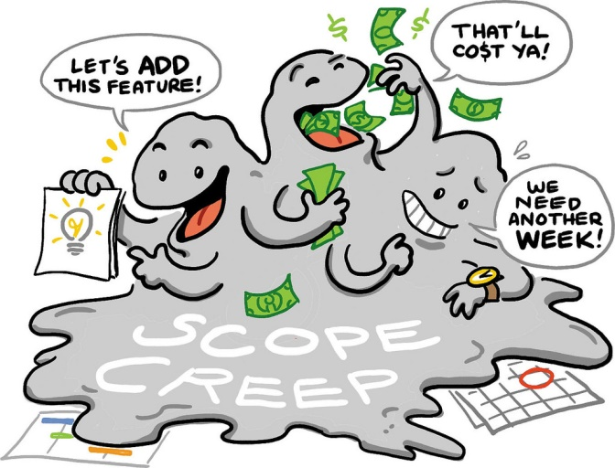
Scope Creep
Scope creep is the process by which a project grows beyond its originally anticipated size.
Even if the project is completed, scope creep can result in final deliverables that look nothing like what was originally envisioned.
Scope creep can occur for a number of reasons, including:
A poor understanding of the original project
Changing market conditions
Competing forces within a company
To avoid the worst kinds of scope creep, a project manager should consider even minor adjustments to the original project scope carefully and rework time lines, provide new estimates and communicate with the stakeholders before integrating changes.

Slide 8
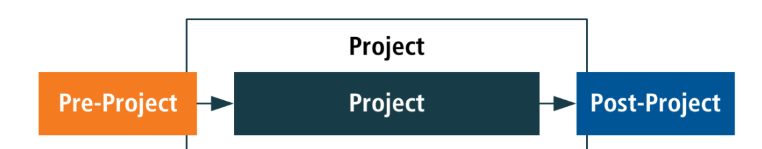
Pre-Project Phase
The work of the pre-project phase simply formalizes a proposal for a project and places it in the context of other potential work to be, or already being, carried out by the organization.
Objectives
To describe the business problem to be addressed.
To identify a Business Sponsor and Business Visionary.
To confirm that the project is in line with business strategy.
To scope, plan and resource the Feasibility phase.
The intended work of the Pre-project phase should be short, sharp and ideally restricted to the creation of a short statement that has the purpose of justifying and prioritising a Feasibility investigation.

Slide 9
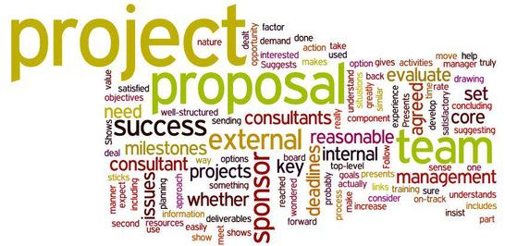
Project Proposal
A project proposal sits outside the boundaries of the project management process groups and is an input (cross boundary) to the initiating process group

Slide 10

Feasibility Study
An analysis and evaluation of a proposed project to determine if it is technically feasible, is feasible within the estimated cost, and will be profitable. Feasibility studies are almost always conducted where large sums are at stake. Also called feasibility analysis.
Objectives:
To establish whether there is a feasible solution to the business problem described in the Terms of Reference defined during Pre-Project.
To identify the benefits likely to arise from the delivery of the proposed solution.
To outline possible approaches for delivery, including strategies for sourcing the solution and project management.
To describe the organisation and governance aspects of the project.
To state first-cut estimates of timescale and costs for the project overall.
To plan and resource the Foundations phase.

Slide 11
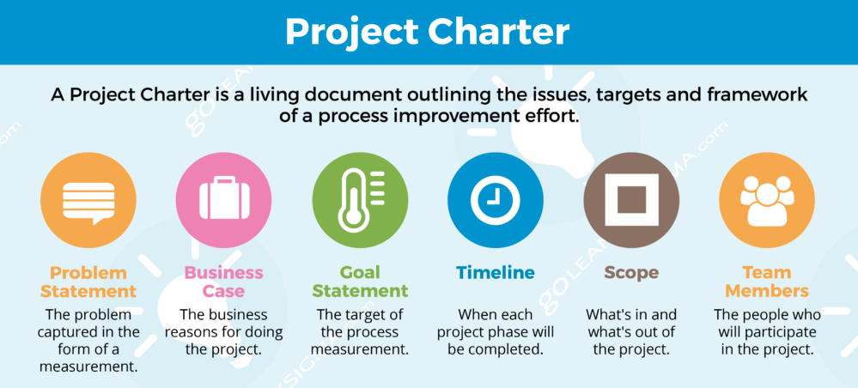
Project Charter
Project Charter refers to a statement of objectives in a project.
This statement also sets out detailed project goals, roles and responsibilities, identifies the main stakeholders, and the level of authority of a project manager.
Objectives:
It documents the reasons for undertaking the project.
Outlines the objectives and the constraints faced by the project.
Provides solutions to the problem in hand.
Identifies the main stakeholders of the project.

Slide 12
Return on Investment (ROI)
A profitability measure that evaluates the performance of a business by dividing net profit by net worth.
Return on investment, or ROI, is the most common profitability ratio.
There are several ways to determine ROI, but the most frequently used method is to divide net profit by total assets.
ROI = Net Profit/Net Worth
Example: If your net profit is $100,000 and your total assets are $300,000, your ROI would be .33 or 33%.
When done right, business analysis can substantially increase the ROI on a software development project in two major ways:
Increased value of the solution
Reduced Implementation cost

Slide 13
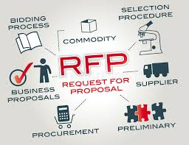
Request for Proposal
A type of bidding solicitation in which a company or organization announces that funding is available for a particular project or program, and companies can place bids for the project's completion.
Outlines the bidding process and contract terms, and provides guidance on how the bid should be formatted and presented.
A RFP is typically open to a wide range of bidders, creating open competition between companies looking for work.

Slide 14
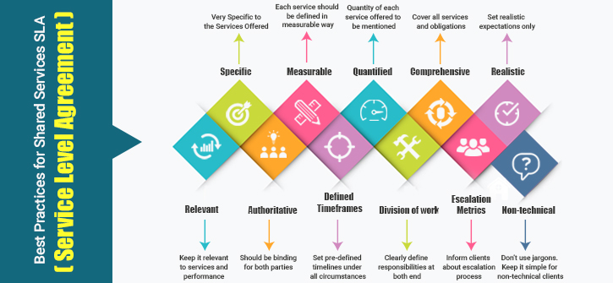
Service Level Agreement (SLA)
A service-level agreement (SLA) is a contract between a service provider and its internal or external customers that documents what services the provider will furnish.
An SLA is a document that describes the minimum performance criteria a provider promises to meet while delivering a service.
It typically also sets out the remedial action and any penalties that will take effect if performance falls below the promised standard.

Slide 15
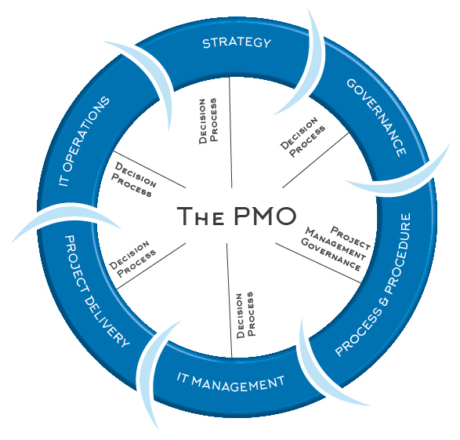
Project Management Office
A Project Management Office (PMO) is a group or department within a business, agency or enterprise that defines and maintains standards for project management within the organization.
The primary goal of a PMO is to achieve benefits from standardizing and following project management policies, processes and methods.

Slide 16

Key Performance Indicators
A key performance indicator (KPI) is a business metric used to evaluate factors that are crucial to the success of an organization.
KPIs differ per organization; business KPIs may be net revenue or a customer loyalty metric, while government might consider unemployment rates.
Also referred to as "key success indicators (KSI)".

Slide 17

SWOT Analysis
SWOT Analysis is a useful technique for understanding your Strengths and Weaknesses, and for identifying both the Opportunities open to you and the Threats you face.
Strengths and weaknesses are often internal to your organization, while opportunities and threats generally relate to external factors.

Slide 18
Requirement Introduction
A requirement is:
A condition or capability needed by a stakeholder to solve a problem or achieve an objective.
A condition or capability that must be met or possessed by a solution or solution component to satisfy a contract, standard, specification, or other formally imposed documents.
Business Requirements Document
A Business Requirements Document is a requirements package that describes business requirements and stakeholder requirements (it documents requirements of interest to the business, rather than documenting business requirements).

Slide 19
Good vs Bad Requirement
Requirement Quality | Examples Of Bad requirements | Examples of good requirements
Atomic | Students will be able to enroll to undergraduate courses and post-graduate courses. | Students will be able to enroll to undergraduate courses. Students will be able to enroll post graduate courses.
Uniquely Identified | 1-Students will be able to enroll to under graduate courses. 1-Students will be able to enroll to post graduate courses | 1 Course Enrollment 1.1 - Students will be able to enroll to under graduate courses. 1.2 - Students will be able to enroll to post graduate courses.
Complete | A professor user will log into the system by providing his username, password and other relavant information | A professor user will login into the system by providing his username, password and department code.
Consistent and Unambiguous | A student will have either under graduate courses or post graduate courses but not both courses. Some courses will open to both to under graduate and post graduate students. | A student will have either under graduate courses or post graduate courses but not both.
Traceble | Maintain student information.. Mapped to BRD req ID? | Maintain student information.. Mapped to BRD req ID 4.1.
Prioritized | Register Student - Priority 1 Maintain Student information - Priority 1 Enroll courses - Priority 1 View Report Card - Priority 1 | Register Student - Priority 1 Maintain Student information - Priority 2 Enroll courses - Priority 1 View Report Card - Priority 3
Testable | Each page of the system will load in an acceptable time frame. | Register Student and enroll courses pages of the system will load within 5 seconds.

Slide 20
Good vs Bad Requirement
Removing Negation from Requirements Bad Example | Good Example
All users with three or more accounts should not be migrated. | The system shall migrate only users having fewer than three accounts.
The registration process will default to International English and will not present a localized experience until country and language are selected. | The registration process shall default to International English. After the user selects the country and language, the registration process shall present a localized experience.
A domain name cannot be transferred to another registrar during the registration grace period. | The domain administrator may transfer a domain name to another registrar only after the registration grace period.
The PC administrator will not have the ability to change the FZL-Web user. | Only the system administrator shall be able to change the FZL-Web user

Slide 21


